Slide 1
Linux History

Slide 2
Unix History
The Unix operating system was conceived and implemented by Dennis, Ritchie, Ken Thompson, Brian W. Kerrington Of Bell Labs in 1969
1970: University of California, Berkeley made further Improvement to UNIX source – included TCP/IP Networking in it. This is known as the BSD (Berkeley Systems Distribution) and initially released in 1977.It became yet another popular flavour of UNIX.
Source code was publicly made available with the license
Modern versions of BSD: NetBSD, OpenBSD and Mac OS X.

Slide 3
Free software movement
UNIX became the basis for a commercialization in 1984
Since then UNIX became expensive and a trademark of AT & T
1983: comes the Richard Stallman of MIT in Cambridge, USA to initiate a battle against proprietary software
This marks the birth of the Free Software Foundation and Subsequently the huge collection of the GNU (Gnu is Not Unix) software
Licensing: give everyone the right to copy, distribute, and Modify the work, though under strict terms and conditions.

Slide 4
Minix
MINIX, a Unix-like system intended for academic use, was released by Andrew S. Tanenbaum in 1987.
While source code for the system was available, modification and redistribution were restricted

Slide 5
Linux
Linus Torvalds at the University of Helsinki in 1988 used Minix in beginning, an Unix-inspired operating system created by Andrew Tannenbaum for use as a teaching tool
Linus was not impressed with the system in general and in particular he lamented its inability to do terminal emulation, which he needed so he could connect to the university's computers.
Linus decided to do the terminal emulation program himself, independently of Minix
Linus quickly developed the terminal emulation program and it was sufficient for his needs for a while. However, Linus began thinking that it would be nice to be able to do other things with it like transferring and saving files. This is where Linux was really born.

Slide 6
WHAT IS LINUX .....?
Linux is a Operating System Kernel , used by Linux family of Unix-like Operating Systems
The Linux kernel is released under the GNU General Public License
Many Linux distributions have been released based upon the Linux kernel.
An operating system using the Linux kernel and including a collection of apps is called LINUX DISTRO or LINUX DISTRIBUTION.
There are hundreds available .Some of the most popular are Red Hat, Fedora, SUSE, Debian, and Ubuntu

Slide 7
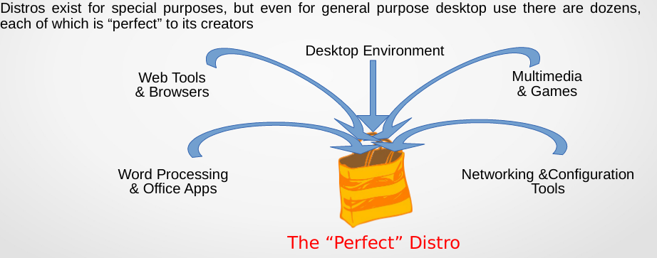
WHAT IS LINUX DISTRO....?
“Distros” (short for Distributions) are collections of software bundled with the Linux kernel and tuned to play well together.

Slide 8
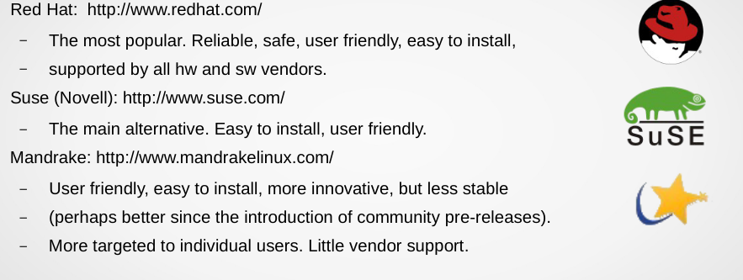
COMMERCIAL DISTROS

Slide 9
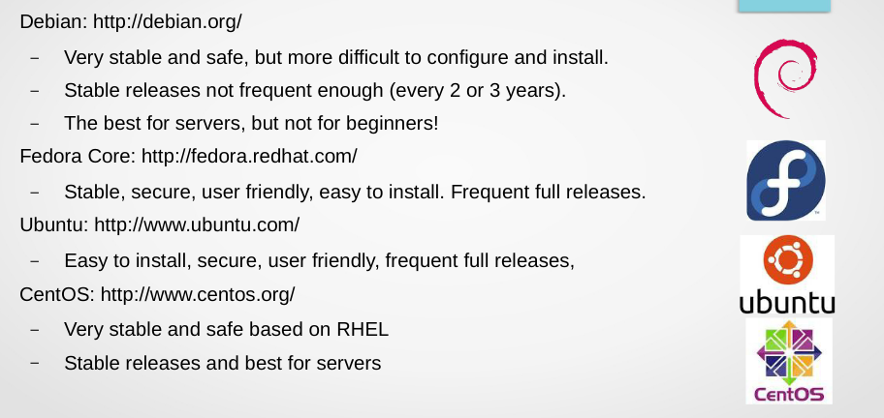
COMMUNITY DRIVEN DISTROS..

Slide 10
WHY LEARN LINUX AS OPPOSED TO OTHER OS ..?
Freedom from price
Freedom from all sorts of entanglements
Freedom – no licensing hassles, expenses, threats, court cases, not locked into a specific product or vendor, no costly upgrades every year
Linux is Open Source Software – i.e. developed by a large community of developers working collaboratively since the source code is freely available to anyone to read and improve. And this cycle is iterative. The Internet is the medium for this development. The Linux kernel is released under the GNU General Public License version 2 (GPLv2)

Slide 11
